Slide 1
Concurrency / Multithreading
Object Oriented Programming -I (3140705)
Dr. Chirag Joshi
Department of ICT
chirag.joshi@marwadieducation.edu.in
9537133260

Slide 2

Outline
Multithreading
Life Cycle of Thread
Creating a Thread
Using Thread Class
Using Runnable Interface
Join
Synchronized
Looping

Slide 3
What is Multithreading?
Multithreading in Java is a process of executing multiple threads simultaneously.
A thread is a lightweight sub-process, the smallest unit of processing.
Multiprocessing and multithreading, both are used to achieve multitasking.
Threads use a shared memory area. They don't allocate separate memory area so saves memory, and context-switching between the threads takes less time than process.
A thread goes through various stages in its life cycle. For example, a thread is born, started, runs, and then dies.
Lets see the life cycle of the thread.

Slide 4
Life cycle of a Thread
There are 5 stages in the life cycle of the Thread
New: A new thread begins its life cycle in the new state. It remains in this state until the program starts the thread. It is also referred to as a born thread.
Runnable: After a newly born thread is started, the thread becomes runnable. A thread in this state is considered to be executing its task.
Waiting: Sometimes a thread transitions to the waiting state while the thread waits for another thread to perform a task. A thread transitions back to the runnable state only when another thread signals waiting thread to continue.
Timed waiting: A runnable thread can enter the timed waiting state for a specified interval of time. A thread in this state transitions back to the runnable state when that time interval expires or when the event it is waiting for occurs.
Terminated: A runnable thread enters the terminated state when it completes its task or otherwise terminates.
new
Program starts
thread
unlock
signal
signalAll
runnable
Thread completes
Task
await
lock
await
sleep
Interval
expires
waiting
timed waiting
terminated

Slide 5
The Main Thread
When a Java program starts up, one thread begins running immediately. This is usually called the main thread of your program, because it is the one that is executed when your program begins. The main thread is important for two reasons:
It is the thread from which other “child” threads will be spawned.
Often, it must be the last thread to finish execution because it performs various shutdown actions.
Although the main thread is created automatically when your program is started, it can
be controlled through a Thread object. To do so, you must obtain a reference to it by calling
the method currentThread( ), which is a public static member of Thread. Its general form is
shown here:
static Thread currentThread( ) This method returns a reference to the thread in which it is called. Once you have a reference
to the main thread, you can control it just like any other thread

Slide 6
The Main Thread
try {
for(int n = 5; n > 0; n--) {
System.out.println(n);
Thread.sleep(1000);
}
} catch (InterruptedException e) {
System.out.println("Main thread interrupted");
}
}
}
// Controlling the main Thread.
class CurrentThreadDemo {
public static void main(String args[]) {
Thread t = Thread.currentThread();
System.out.println("Current thread: " + t);
// change the name of the thread
t.setName("My Thread");
System.out.println("After name change: " + t);

Slide 7
Creating a Thread in Java
There are two ways to create a Thread
extending the Thread class
implementing the Runnable interface

Slide 8
1) Extending Thread Class
One way to create a thread is to create a new class that extends Thread, and then to create an instance of that class.
The extending class must override the run( ) method, which is the entry point for the new thread.
It must also call start( ) to begin execution of the new thread.
class NewThread extends Thread {
NewThread() {
super("Demo Thread");
System.out.println("Child thread: " + this);
start(); // Start the thread
}
public void run() {
try {
for (int i = 5; i > 0; i--) {
System.out.println("Child Thread: " + i);
Thread.sleep(500);
}
} catch (InterruptedException e) {
System.out.println("Child interrupted.");
}
System.out.println("Exiting child thread.");
}}
class ExtendThread {
public static void main(String args[]) {
new NewThread(); // create a new thread
try {
for (int i = 5; i > 0; i--) {
System.out.println("Main Thread: " + i);
Thread.sleep(1000);
}
} catch (InterruptedException e) {
System.out.println("Main thread interrupted.");
}
System.out.println("Main thread exiting.");
}
}

Slide 9
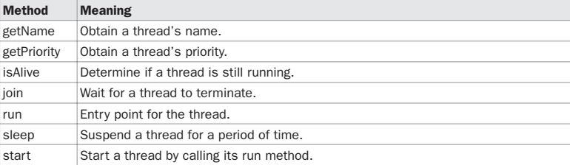
Runnable Interface
The Thread class defines several methods that help manage threads

Slide 10
2) Implementing Runnable Interface
To implement thread using Runnable interface, Runnable interface needs to be implemented by the class.
class NewThread implements Runnable
Class which implements Runnable interface should override the run() method which contains the logic of the thread.
public void run( )
Instance of Thread class is created using following constructor.
Thread(Runnable threadOb, String threadName);
Here threadOb is an instance of a class that implements the Runnable interface and the name of the new thread is specified by threadName.
start() method of Thread class will invoke the run() method.

Slide 11
Using isAlive( ) and join( )
Two ways exist to determine whether a thread has finished. First, you can call isAlive( ) on the thread. This method is defined by Thread, and its general form is shown here:
final boolean isAlive( )
The isAlive( ) method returns true if the thread upon which it is called is still running. It returns
false otherwise.
While isAlive( ) is occasionally useful, the method that you will more commonly use to
wait for a thread to finish is called join( )
Implement the program mentioned at page 235, complete reference

Slide 12
Thread Priority
To set a thread’s priority, use the setPriority( ) method, which is a member of Thread. This is its general form:
final void setPriority(int level)
Here, level specifies the new priority setting for the calling thread. The value of level must be within the range MIN_PRIORITY and MAX_PRIORITY. Currently, these values are 1 and 10, respectively. To return a thread to default priority, specify NORM_PRIORITY, which is currently 5. These priorities are defined as static final variables within Thread.
You can obtain the current priority setting by calling the getPriority( ) method of Thread, shown here:
final int getPriority( )

Slide 13
Thread using Executor Framework
Steps to execute thread using Executor Framework are as follows:
Create a task (Runnable Object) to execute
Create Executor Pool using Executors
Pass tasks to Executor Pool
Shutdown the Executor Pool

Slide 14
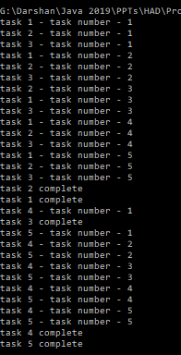
Example Executable Framework
class Task implements Runnable {
private String name;
public Task(String s) {
name = s;
}
public void run() {
try {
for (int i = 1; i<=5; i++) {
System.out.println(name+" - task number - "+i);
Thread.sleep(1000);
}
System.out.println(name+" complete");
}
catch(InterruptedException e) {
e.printStackTrace();
}
}
}
import java.util.concurrent.*;
public class ExecutorThreadDemo {
public static void main(String[] args) {
Runnable r1 = new Task("task 1");
Runnable r2 = new Task("task 2");
Runnable r3 = new Task("task 3");
Runnable r4 = new Task("task 4");
Runnable r5 = new Task("task 5");
ExecutorService pool = Executors.newFixedThreadPool(3);
pool.execute(r1);
pool.execute(r2);
pool.execute(r3);
pool.execute(r4);
pool.execute(r5);
pool.shutdown();
}
}

Slide 15
Thread Synchronization
When we start two or more threads within a program, there may be a situation when multiple threads try to access the same resource and finally they can produce unforeseen result due to concurrency issues.
For example, if multiple threads try to write within a same file then they may corrupt the data because one of the threads can override data or while one thread is opening the same file at the same time another thread might be closing the same file.
So there is a need to synchronize the action of multiple threads and make sure that only one thread can access the resource at a given point in time.
Java programming language provides a very handy way of creating threads and synchronizing their task by using synchronized methods & synchronized blocks.

Slide 16
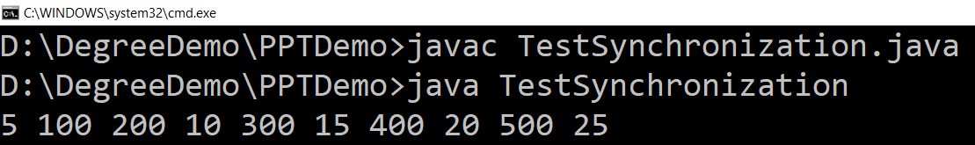
Problem without synchronization (Example)
class Table {
void printTable(int n) { for (int i = 1; i <= 5; i++) {
System.out.print(n * i + " ");
try {
Thread.sleep(400);
} catch (Exception e) {
System.out.println(e);
}
}
}
}
class MyThread1 extends Thread {
Table t;
MyThread1(Table t) {
this.t = t;
}
public void run() {
t.printTable(5);
}
}
class MyThread2 extends Thread {
Table t;
MyThread2(Table t) {
this.t = t;
}
public void run() {
t.printTable(100);
}
}
public class TestSynchronization {
public static void main(String args[]){
Table obj = new Table();
MyThread1 t1 = new MyThread1(obj);
MyThread2 t2 = new MyThread2(obj);
t1.start();
t2.start();
}
}

Slide 17
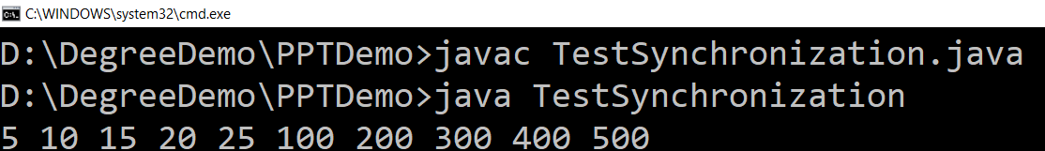
Solution with synchronized method
class Table {
synchronized void printTable(int n) { for (int i = 1; i <= 5; i++) {
System.out.print(n * i + " ");
try {
Thread.sleep(400);
} catch (Exception e) {
System.out.println(e);
}
}
}
}
class MyThread1 extends Thread {
Table t;
MyThread1(Table t) {
this.t = t;
}
public void run() {
t.printTable(5);
}
}
class MyThread2 extends Thread {
Table t;
MyThread2(Table t) {
this.t = t;
}
public void run() {
t.printTable(100);
}
}
public class TestSynchronization {
public static void main(String args[]){
Table obj = new Table();
MyThread1 t1 = new MyThread1(obj);
MyThread2 t2 = new MyThread2(obj);
t1.start();
t2.start();
}
}

Slide 18
Solution with synchronized blocks
class Table {
void printTable(int n) { for (int i = 1; i <= 5; i++) {
System.out.print(n * i + " ");
try {
Thread.sleep(400);
} catch (Exception e) {
System.out.println(e);
}
}
}
}
class MyThread1 extends Thread {
Table t;
MyThread1(Table t) {
this.t = t;
}
public void run() {
synchronized (t) {
t.printTable(5);
}
}
}
class MyThread2 extends Thread {
Table t;
MyThread1(Table t) {
this.t = t;
}
public void run() {
synchronized (t) {
t.printTable(100);
}
}
}
public class TestSynchronization {
public static void main(String args[]){
Table obj = new Table();
MyThread1 t1 = new MyThread1(obj);
MyThread2 t2 = new MyThread2(obj);
t1.start();
t2.start();
}
}

